Slide 1
Thesis Discussion
Emilio Benenati
Josyula Viswanath Das

Slide 2




MPC
States
Input
Output
Reference

Slide 3

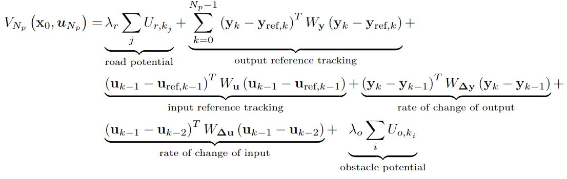
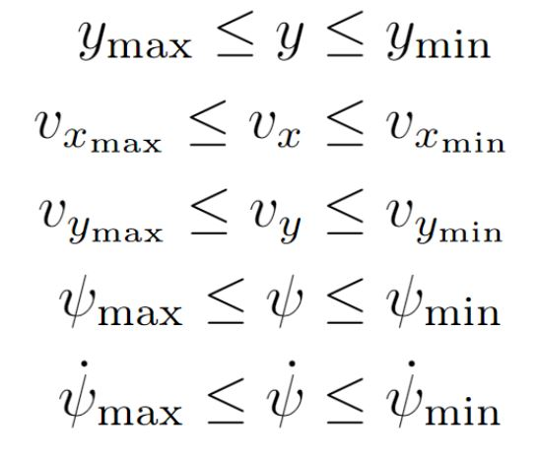
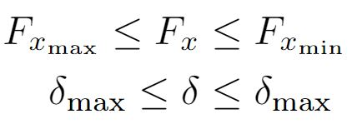
Objective Function
State Constraint
Input Constraint

Slide 4
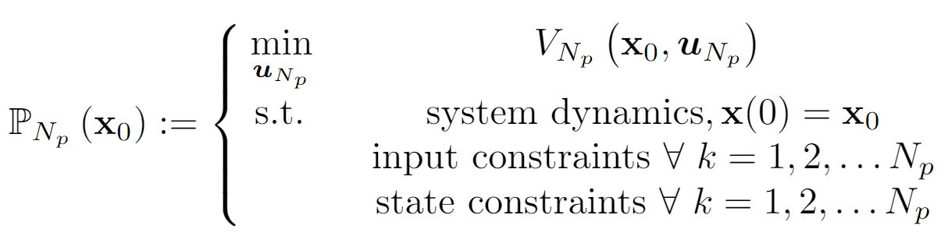

Slide 5



Reference Calculation
, and are set to zero
and are calculated as follows

Slide 6
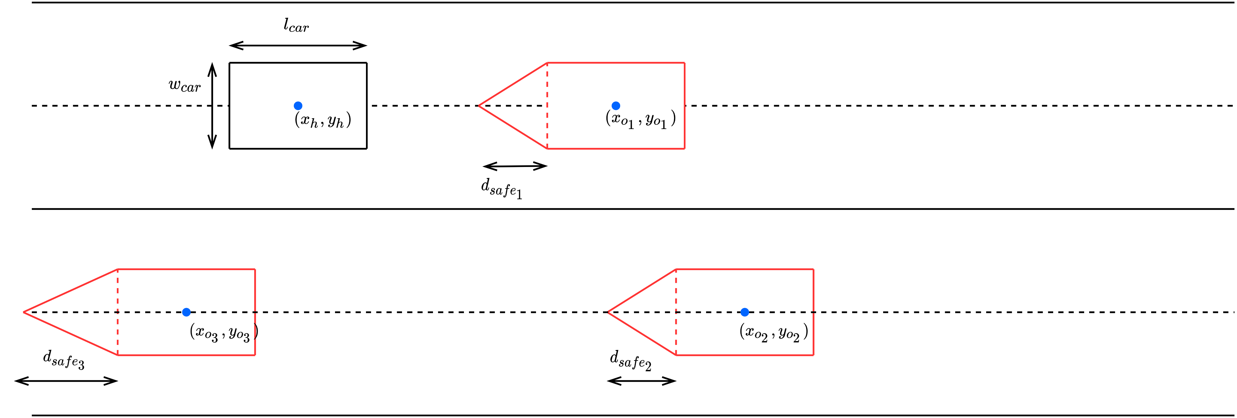

Slide 7
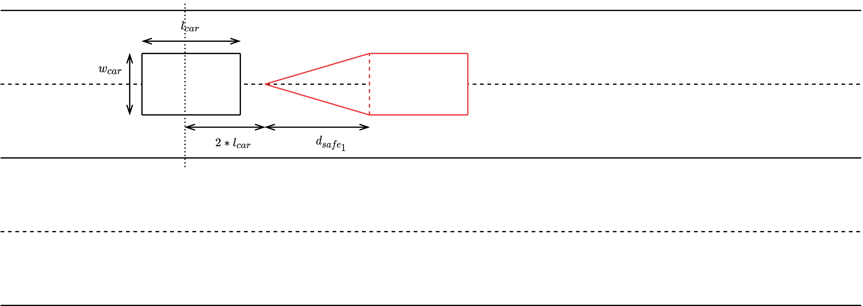

Slide 8
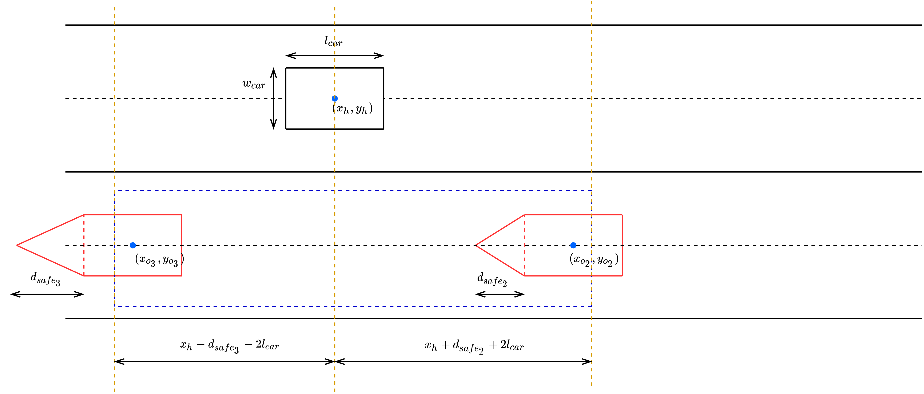

Slide 11
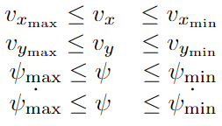

Mixed Integer Programming
Solvers available: Gurobi/CPLEX.
Question: What are we actually trying to set as an integer variable?
Lane center which is directly related to lateral position
Real State Constraints
Integer State Constraints

Slide 12
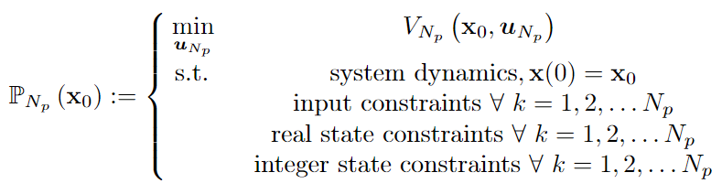

Slide 13
To increase complexity, we can however assume that we get information about the changes in the lane from the other vehicles along with their states and define integer constraints to help define safe lane changes (Section III- B of the paper)
Help to understand IV- B

Slide 14
Questions to ask
What do we do about the convexification of the APF into multiple regions? And how do we connect it to lane position?

